Slide 1
Regression Analysis
(Summary)
Heungsun Park
HUFS
Simple Regression I
Copyright © 2005 Brooks/Cole, a division of Thomson Learning, Inc.

Slide 2
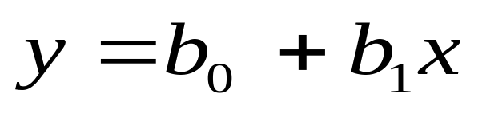
3.1 Using Simple Regression to Describe a Relationship
Regression analysis is a statistical technique used to describe relationships among variables.
The simplest case is one where a dependent variable y may be related to an independent or explanatory variable x.
The equation expressing this relationship is the line:
Simple Regression I
Copyright © 2005 Brooks/Cole, a division of Thomson Learning, Inc.

Slide 3
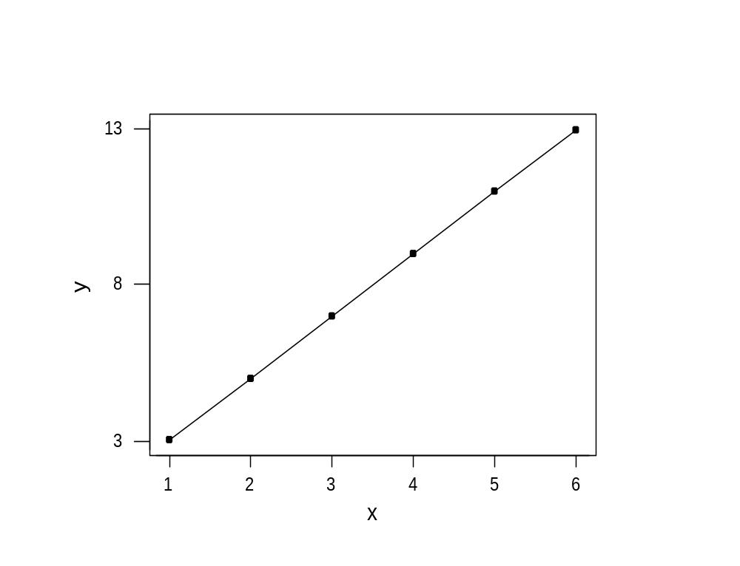
Figure 3.1 Graph of An Exact Relationship
x | y
1 | 3
2 | 5
3 | 7
4 | 9
5 | 11
6 | 13
Simple Regression I
Copyright © 2005 Brooks/Cole, a division of Thomson Learning, Inc.

Slide 4
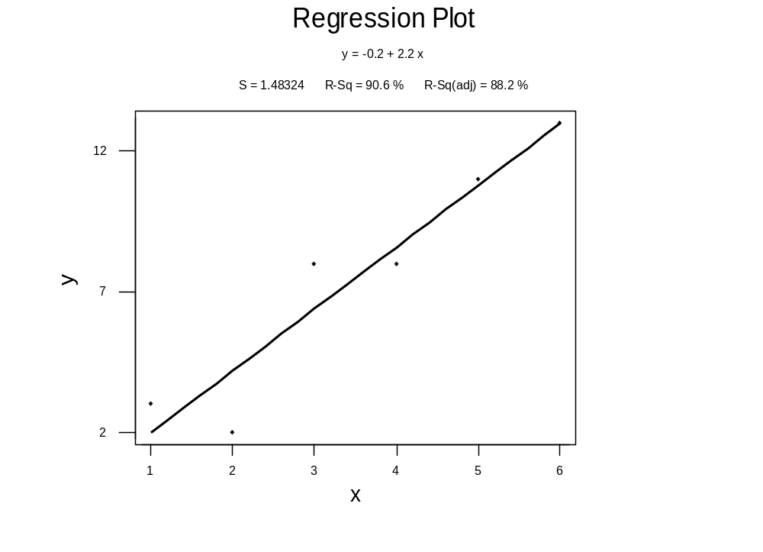
Figure 3.2 Graph of a Relationship That is NOT Exact
x | y
1 | 3
2 | 2
3 | 8
4 | 8
5 | 11
6 | 13
Simple Regression I
Copyright © 2005 Brooks/Cole, a division of Thomson Learning, Inc.

Slide 5
Figure 3.3 Deviations From the Line
+ deviations
- deviations
Simple Regression I
Copyright © 2005 Brooks/Cole, a division of Thomson Learning, Inc.

Slide 6
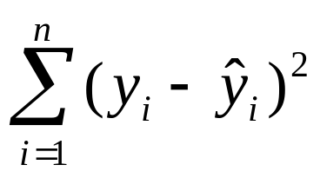
Computation Ideas (3)
By far the most popular approach is to square the residuals and minimize:
This procedure is called least squares and is widely available in software. It uses calculus to solve for the b₀ and b₁ terms and gives a unique solution.
Simple Regression I
Copyright © 2005 Brooks/Cole, a division of Thomson Learning, Inc.

Slide 7
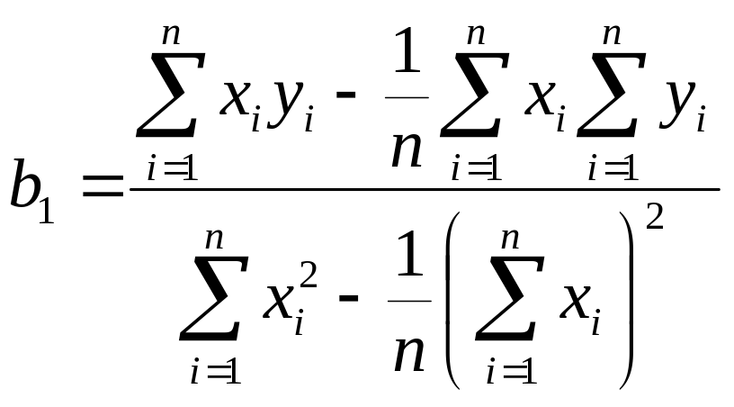
Least Squares Estimators
There are several formula for the b₁ term. If doing it by hand, we might want to use:
_ _
The intercept is b₀ = y – b₁ x
Simple Regression I
Copyright © 2005 Brooks/Cole, a division of Thomson Learning, Inc.

Slide 8
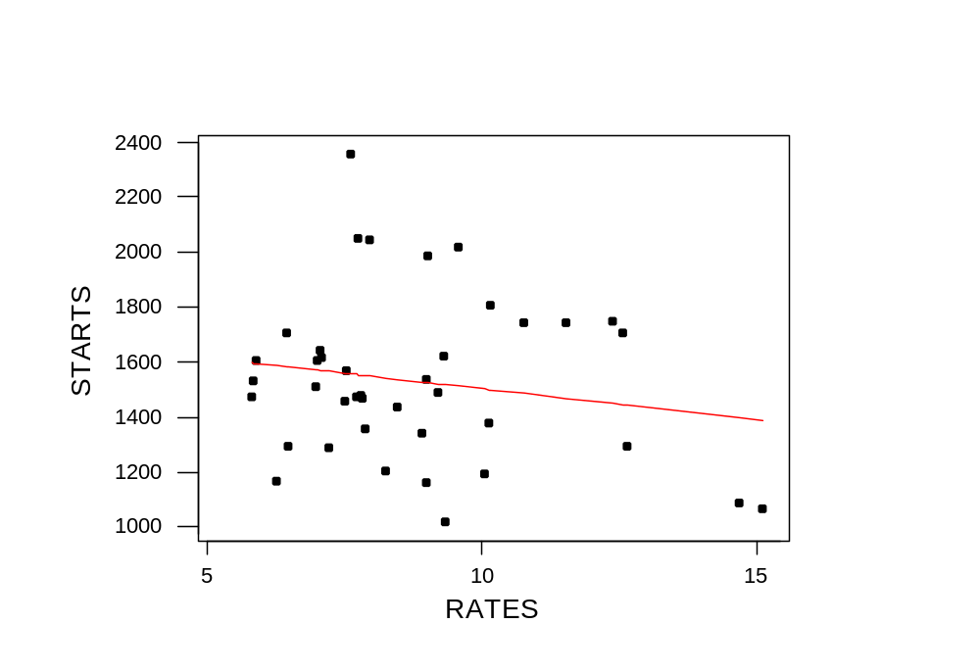
US Housing Starts
STARTS = 1726 - 22.2 RATES
Simple Regression I
Copyright © 2005 Brooks/Cole, a division of Thomson Learning, Inc.

Slide 9
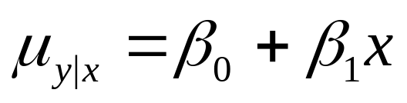
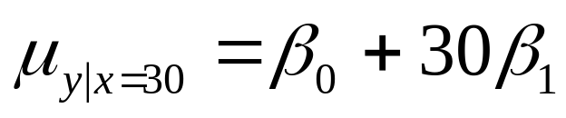
The Conditional Mean
Our first assumption is that the means of these distributions all lie on a straight line:
For example, at projects with 30 ports, we have:
The actual cost of projects with 30 ports are going to be distributed about the mean. This also happens at other sizes of projects, so you might see something like the next slide.
Simple Regression I
Copyright © 2005 Brooks/Cole, a division of Thomson Learning, Inc.

Slide 10

Figure 3.12 Distribution of Costs around the Regression Line
Cost
β₀ + β₁ Nodes
Nodes
12
30
68
Simple Regression I
Copyright © 2005 Brooks/Cole, a division of Thomson Learning, Inc.

Slide 11
Assumptions
We expect the average disturbance e_{i} to be zero so the regression line passes through the conditional mean of y.
The e_{i} have constant variance σ_{e}².
The e_{i} are normally distributed.
The e_{i} are independent.
Simple Regression I
Copyright © 2005 Brooks/Cole, a division of Thomson Learning, Inc.

Slide 12
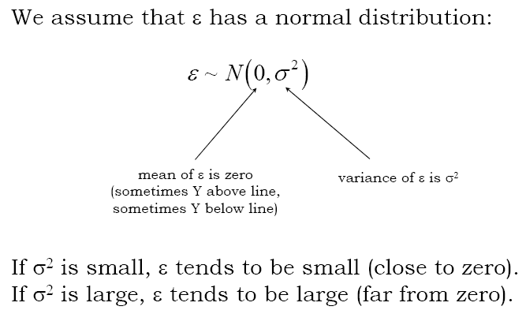
Simple Regression I
Copyright © 2005 Brooks/Cole, a division of Thomson Learning, Inc.

Slide 13
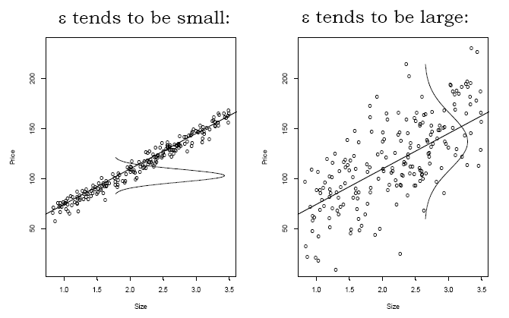
Simple Regression I
Copyright © 2005 Brooks/Cole, a division of Thomson Learning, Inc.

Slide 14
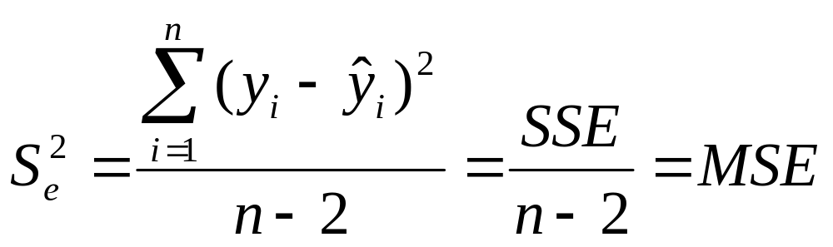
Estimate of σ_{e}²
This is an unknown quantity that needs to be estimated from data.
We estimate it by the formula:
The term MSE stands for mean squared error and is more or less the average squared residual.
Simple Regression I
Copyright © 2005 Brooks/Cole, a division of Thomson Learning, Inc.

Slide 15
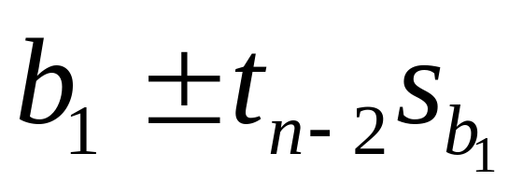
Interval Estimate
The distribution we use is a t with
  n-2 degrees of freedom.
The interval is:
The value of t, of course, depends on the selected confidence level.
Simple Regression I
Copyright © 2005 Brooks/Cole, a division of Thomson Learning, Inc.

Slide 16
Tests About β₁
The most common test is that a change in the x variable does not induce a change in y, which can be stated:
  H₀: β₁ = 0
  H_{a}: β₁ ≠ 0
If H₁ is true it implies the population regression equation is a flat line; that is, regardless of the value of x, y has the same distribution.
Simple Regression I
Copyright © 2005 Brooks/Cole, a division of Thomson Learning, Inc.

Slide 17
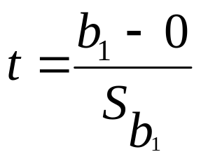
Test Statistic
The test would be performed by using the standardized test statistic:
Most computer programs compute this, and its associated p-value. and include them on the output.
The p-value is for the two-sided version of the test.
Simple Regression I
Copyright © 2005 Brooks/Cole, a division of Thomson Learning, Inc.

Slide 18
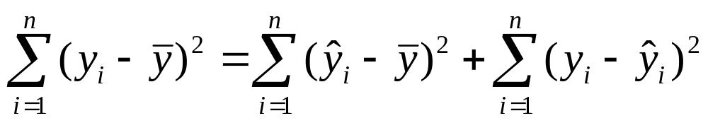
Partitioning SST
SST can be split into two pieces which are the previously introduced SSE and a new quantity, SSR, the regression sum of squares.
SST = SSR + SSE
Simple Regression II
Copyright © 2005 Brooks/Cole, a division of Thomson Learning, Inc.

Slide 19
The ANOVA Table
Most statistics packages organize these quantities in an ANalysis Of VAriance table.
Source | DF | SS | MS | F
Regression | 1 | SSR | MSR | MSR/MSE
Residual | n-2 | SSE | MSE
Total | n-1 | SST
Simple Regression II
Copyright © 2005 Brooks/Cole, a division of Thomson Learning, Inc.

Slide 20
R²
SSR
R² = —— is a fraction between 0 and 1
SST
In an exact model, R² would be 1. Most of the time we multiply by 100 and report it as a percentage.
Thus, R² is the percentage of the variation in the sample of y values that is explained by the regression equation.
Simple Regression II
Copyright © 2005 Brooks/Cole, a division of Thomson Learning, Inc.

Slide 21
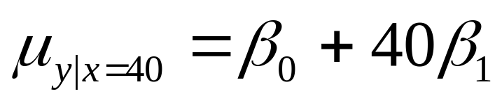
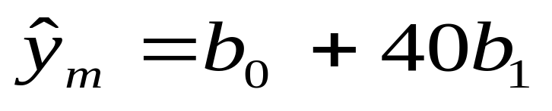
3.5.1 Estimating the Conditional Mean of y Given x.
At x_{m} = 40 ports, the quantity we are estimating is:
Our best guess of this is just the point on the regression line:
Simple Regression II
Copyright © 2005 Brooks/Cole, a division of Thomson Learning, Inc.

Slide 22
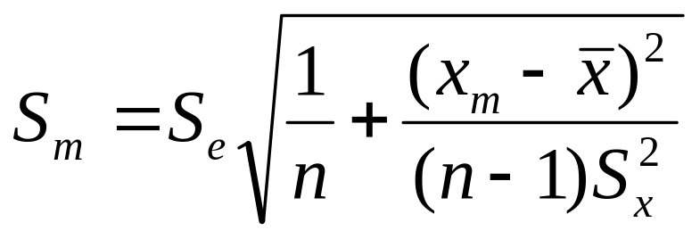
Standard Error of the Mean
We will want to make an interval estimate, so we need some kind of standard error.
Because our point estimate is a function of the random variables b₀ and b₁ their standard errors figure into our computation.
The result is:
Simple Regression II
Copyright © 2005 Brooks/Cole, a division of Thomson Learning, Inc.

Slide 23
Interval Estimate
For estimating the conditional mean of y that occurs at x_{m} we use:
^
y_{m} ± t_{n-2} S_{m}
We call this a confidence interval for the mean value of y at x_{m}.
Simple Regression II
Copyright © 2005 Brooks/Cole, a division of Thomson Learning, Inc.

Slide 24
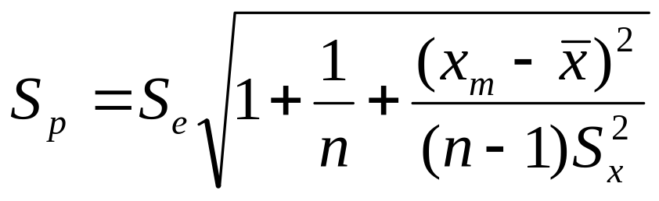
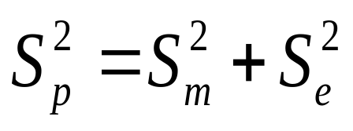
Prediction Standard Error
It can be show that the prediction standard error is:
This looks a lot like the previous one but has an additional term under he square root sign.
The relationship is:
Simple Regression II
Copyright © 2005 Brooks/Cole, a division of Thomson Learning, Inc.

Slide 25
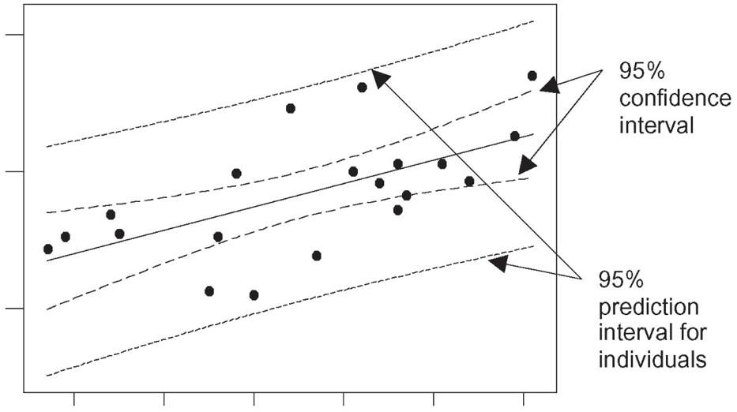
C.I. vs P.I.
Simple Regression II
Copyright © 2005 Brooks/Cole, a division of Thomson Learning, Inc.

Slide 26
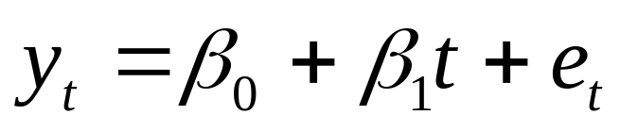
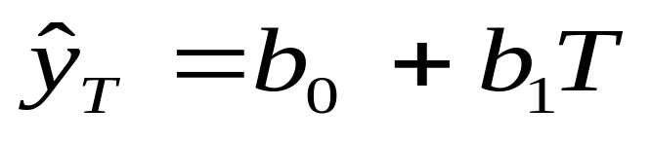
The Linear Trend Model
We assume the series displays a steady upward or downward behavior over time that can be described by:
where t is the time index (t =1 for the first observation, t=2 for the second, and so forth).
The forecast for this model is quite simple:
You just insert the appropriate value for T into the regression equation.
Simple Regression II
Copyright © 2005 Brooks/Cole, a division of Thomson Learning, Inc.

Slide 27
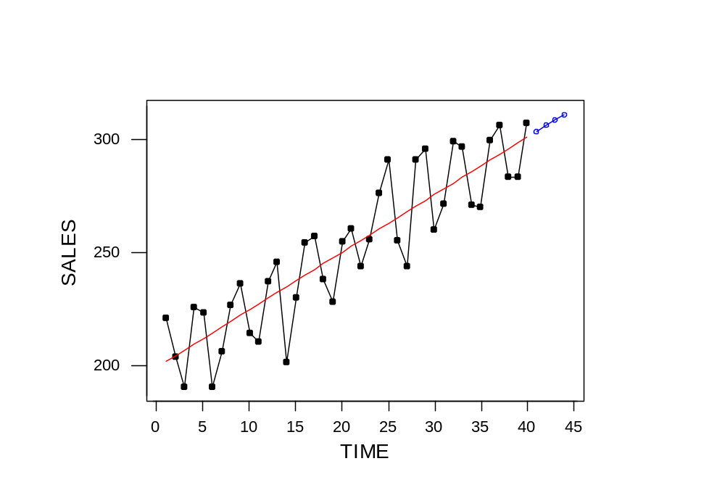
Data, Trend (—) and Forecast (---)
Simple Regression II
Copyright © 2005 Brooks/Cole, a division of Thomson Learning, Inc.

Slide 28
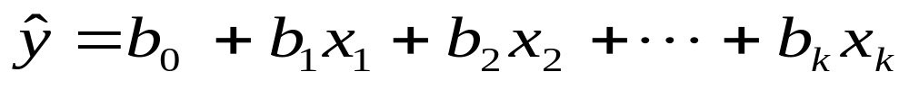
4.1 Using Multiple Regression
In Chapter 3, the method of least squares was used to describe the relationship between a dependent variable y and an explanatory variable x.
Here we extend that to two or more predictor variables, using an equation of the form:
Multiple Regression I
Copyright © 2005 Brooks/Cole, a division of Thomson Learning, Inc.

Slide 29
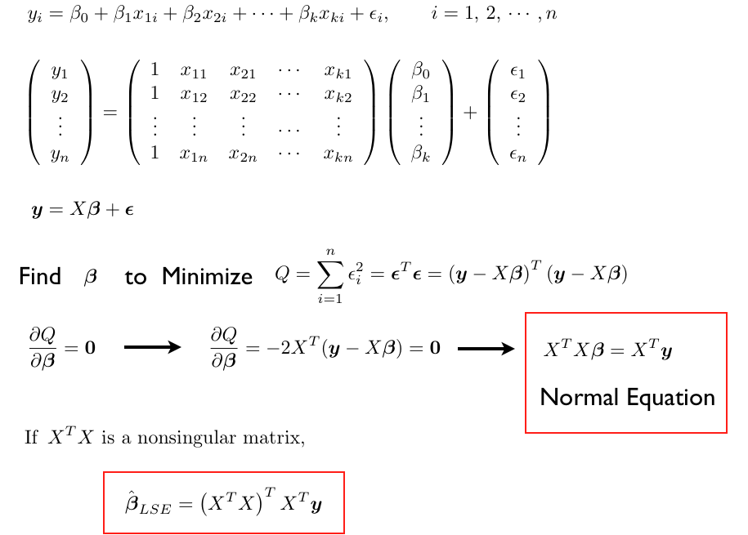
Multiple Regression I
Copyright © 2005 Brooks/Cole, a division of Thomson Learning, Inc.

Slide 30
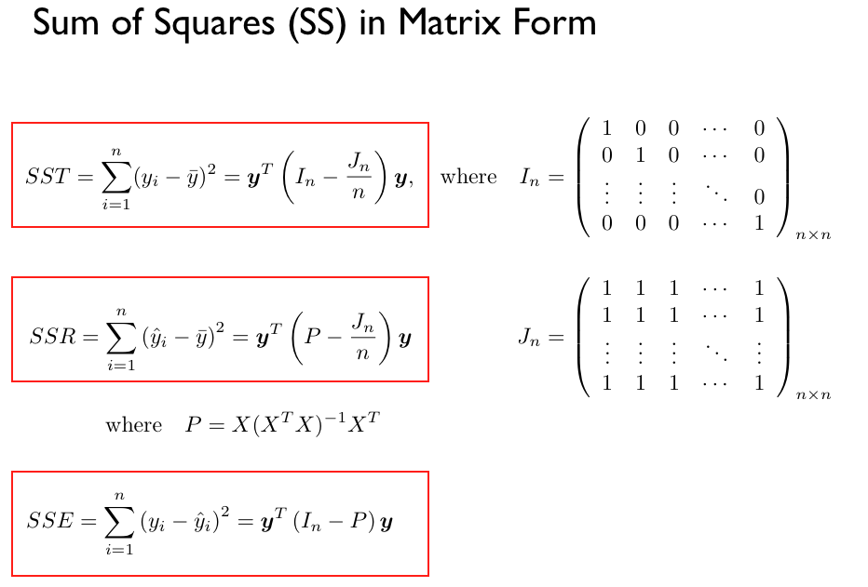
Multiple Regression I
Copyright © 2005 Brooks/Cole, a division of Thomson Learning, Inc.

Slide 31
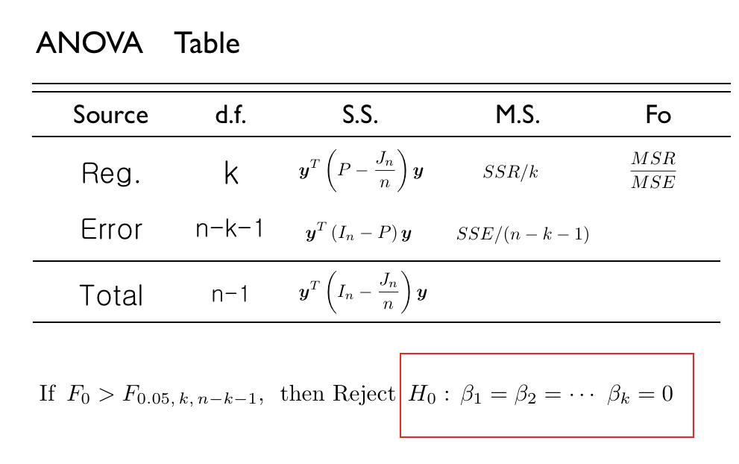
Multiple Regression I
Copyright © 2005 Brooks/Cole, a division of Thomson Learning, Inc.

Slide 32
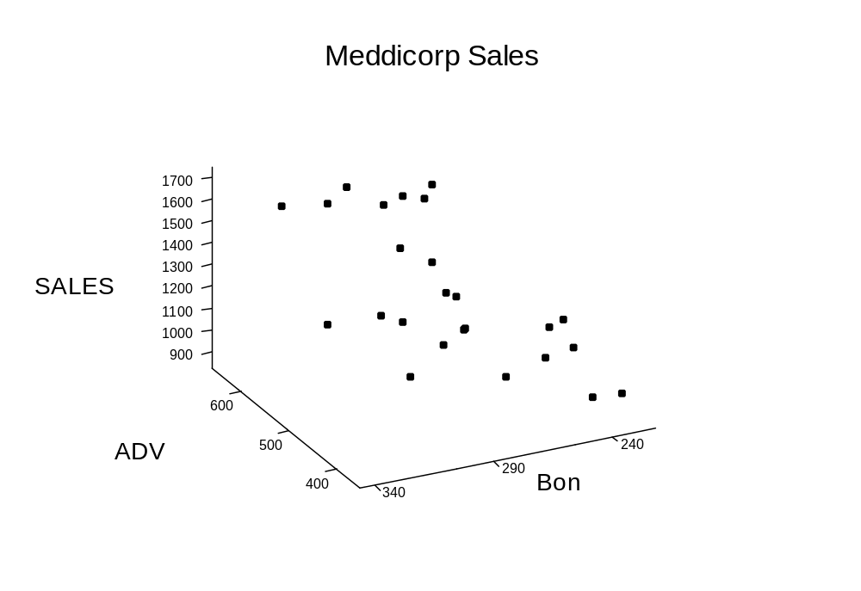
3D Graphics
Multiple Regression I
Copyright © 2005 Brooks/Cole, a division of Thomson Learning, Inc.

Slide 33
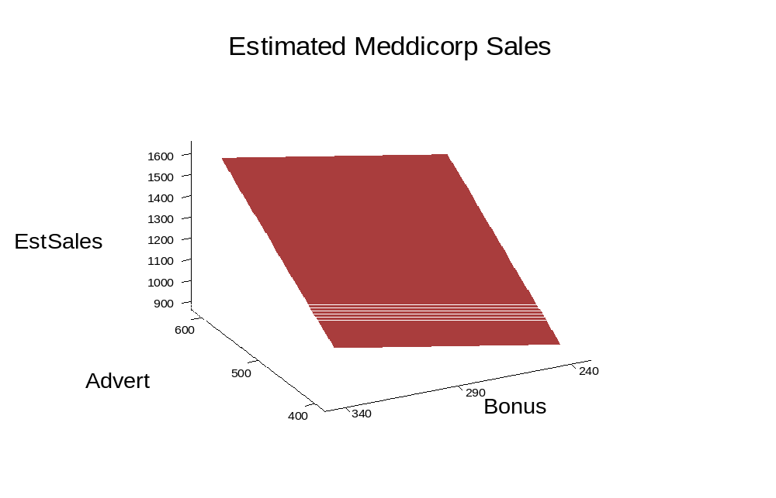
3D Surface Graph
The regression equation is
SALES = - 516 + 2.47 ADV + 1.86 BONUS
Multiple Regression I
Copyright © 2005 Brooks/Cole, a division of Thomson Learning, Inc.

Slide 34
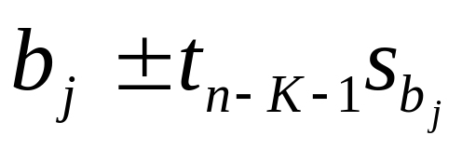
4.2.2 Inferences about the Population Regression Coefficients
If we wish to make an estimate of the effect of a change in one of the x variables on y, use the interval:
this refers to the j^{th} of the K regression coefficients. The multiplier t is selected from the t-distribution with n-K-1 degrees of freedom.
Multiple Regression I
Copyright © 2005 Brooks/Cole, a division of Thomson Learning, Inc.

Slide 35
Tests About the Coefficients
A test about the marginal effect of x_{j} on y may be obtained from:
H₀: β_{j} = β_{j}*
H_{a}: β_{j} ≠ β_{j}*
where β_{j}* is some specific value that is relevant for the j^{th} coefficient.
Multiple Regression I
Copyright © 2005 Brooks/Cole, a division of Thomson Learning, Inc.

Slide 36
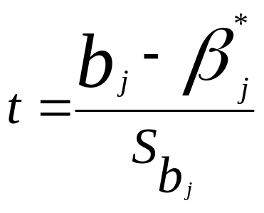
Test Statistic
The test would be performed by using the standardized test statistic:
The most common form of this test is for the parameter to be 0. In this case the test statistic is just the estimate divided by its standard error.
Multiple Regression I
Copyright © 2005 Brooks/Cole, a division of Thomson Learning, Inc.

Slide 37
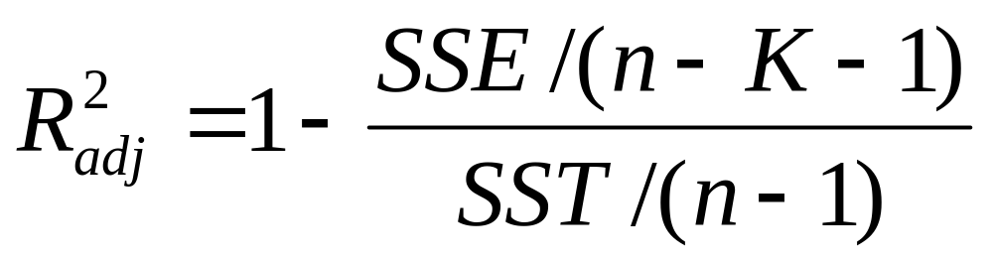
Computation
The "adjustment" is for the number of variables in the model.
Although regular R² may decrease when you remove a variable, the adjusted version may actually increase if that variable did not have much significance.
Multiple Regression I
Copyright © 2005 Brooks/Cole, a division of Thomson Learning, Inc.

Slide 38
F Test Hypotheses
H₀: β₁ = β₂ = …= β_{K} = 0 (None of the Xs
help explain Y)
H_{a}: Not all βs are 0 (At least one X is useful)
H₀: R² = 0 is an equivalent hypothesis
Multiple Regression I
Copyright © 2005 Brooks/Cole, a division of Thomson Learning, Inc.

Slide 39
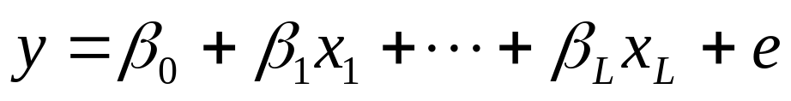
The Two Models
For convenience, let's assume the group is the last (K-L) variables. The Full Model is:
The Reduced Model is just:
Multiple Regression II
Copyright © 2005 Brooks/Cole, a division of Thomson Learning, Inc.

Slide 40
The Partial F Test
We test the group for significance with another F test. The hypothesis is:
H₀: β_{L+1} = β_{L+2} = …= β_{K} = 0
H_{a}: At least one β ≠ 0
The test is performed by seeing how much SSE changes between models.
Multiple Regression II
Copyright © 2005 Brooks/Cole, a division of Thomson Learning, Inc.

Slide 41
The Partial F Statistic
Let SSE_{F} and SSE_{R} denote the SSE in the full and reduced models.
(SSE_{R} – SSE_{F}) / (K – L)
F =
SSE_{F} / (n-K-1)
The statistic has (K-L) numerator and (n-K-1) denominator d.f.
Multiple Regression II
Copyright © 2005 Brooks/Cole, a division of Thomson Learning, Inc.

Slide 42
4.6.1 Consequences of Multicollinearity
The standard errors of the b_{j} are larger than they should be. This could cause all the t statistics to be near 0 even though the F is large.
It is hard to get good estimates of the β_{j}. The b_{j} may have the wrong sign. They may have large changes in value if another variable is dropped from or added to the regression.
Multiple Regression II
Copyright © 2005 Brooks/Cole, a division of Thomson Learning, Inc.

Slide 43
4.6.2 Detecting Multicollinearity
Several methods appear in the literature. Some of these are:
  Examining pairwise correlations
  Seeing large F but small t ratios
  Computing Variance Inflation Factors
Multiple Regression II
Copyright © 2005 Brooks/Cole, a division of Thomson Learning, Inc.

Slide 44
Auxiliary Regressions
Suppose we regressed each x value, in turn, on all of the other x variables.
Let R_{j}² denote the model's R² we get when x_{j} was the "temporary y".
1
The variable's VIF is VIF_{j} =
1 - R_{j}²
Multiple Regression II
Copyright © 2005 Brooks/Cole, a division of Thomson Learning, Inc.

Slide 45
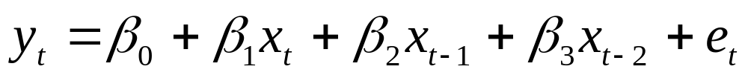
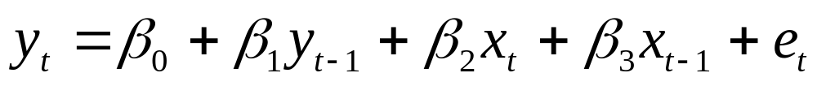
Another Examples for Correlated Predictors
Lagged Independent Variables
Lagged Dependent & Independent Variables
Multiple Regression II
Copyright © 2005 Brooks/Cole, a division of Thomson Learning, Inc.

Slide 46
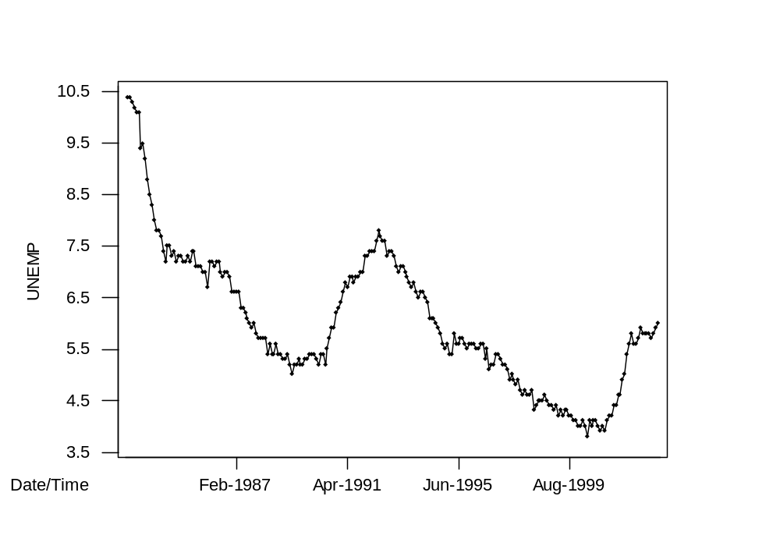



Time Series Plot
Autocorrelation is .97 at lag 1 and .94 at lag 2
Multiple Regression II
Copyright © 2005 Brooks/Cole, a division of Thomson Learning, Inc.

Slide 47
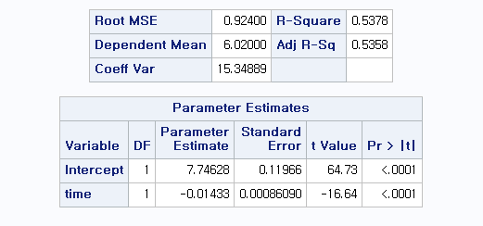
Trend Model
PROC REG;
MODEL UNEMP = TIME ;
RUN:
Multiple Regression II
Copyright © 2005 Brooks/Cole, a division of Thomson Learning, Inc.

Slide 48
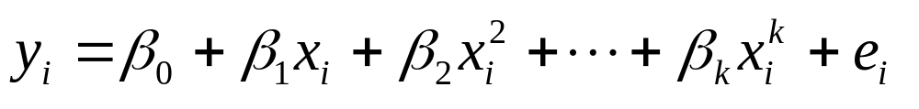
5.2 Fitting Curvilinear Relationships
Polynomial Regression – a common correction for nonlinearity is to add powers of the explanatory variable
In practice a second-order model is often sufficient to describe the relationship
Fitting Curves to Data
Copyright © 2005 Brooks/Cole, a division of Thomson Learning, Inc.

Slide 49
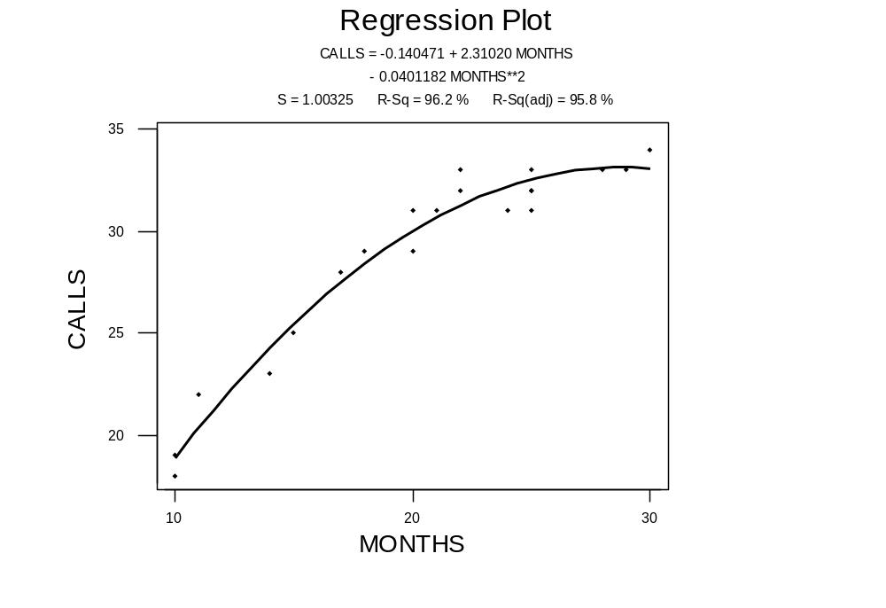
Fitting a Second-Order Model
Fitting Curves to Data
Copyright © 2005 Brooks/Cole, a division of Thomson Learning, Inc.

Slide 50
Hypothesis Tests "Top Down"
The usual practice is to keep lower-order terms when a high-order term is significant.
In b₀ + b₁ x + b₂ x² we would retain the b₁ term even if it had an insignificant t-ratio, if the b₂ term was significant.
Fitting Curves to Data
Copyright © 2005 Brooks/Cole, a division of Thomson Learning, Inc.

Slide 51
Higher and higher?
To see if the polynomial has even a higher order, we fit a cubic equation.
The table below shows the second-order model was sufficient.
Model | p for highest order term | R² | Adj R² | S_{e}
Linear | 0.000 | 87.4% | 86.7% | 1.787
Quadratic | 0.000 | 96.2% | 95.8% | 1.003
Cubic | 0.509 | 96.3% | 95.7% | 1.020
Fitting Curves to Data
Copyright © 2005 Brooks/Cole, a division of Thomson Learning, Inc.

Slide 52
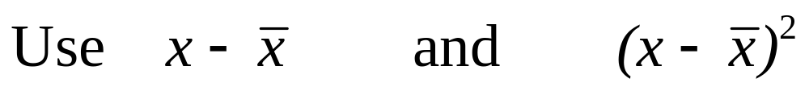
Centering the X
When polynomial regression is used, multicollinearity often results because x and x² are correlated.
This can be eliminated by subtracting x-bar (the mean) from each x
Fitting Curves to Data
Copyright © 2005 Brooks/Cole, a division of Thomson Learning, Inc.

Slide 53
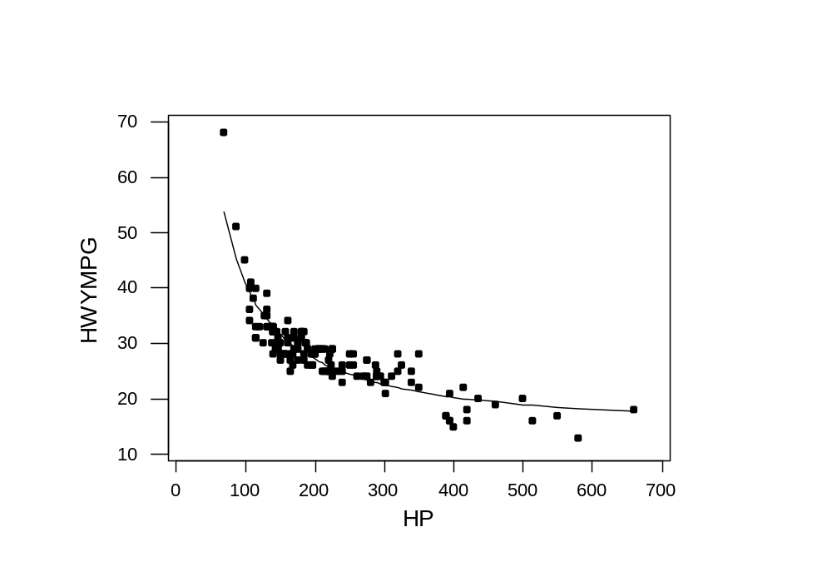
Data and Reciprocal Fit
Fitting Curves to Data
Copyright © 2005 Brooks/Cole, a division of Thomson Learning, Inc.

Slide 54
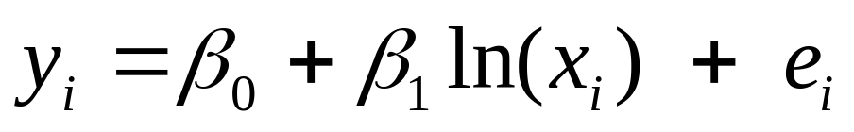
5.2.3 Log Transformation of the x Variable
Yet another curvilinear equation is:
where ln(x) is the natural logarithm of x.
It is assumed that the x values are positive because ln(0) is undefined.
Fitting Curves to Data
Copyright © 2005 Brooks/Cole, a division of Thomson Learning, Inc.

Slide 55
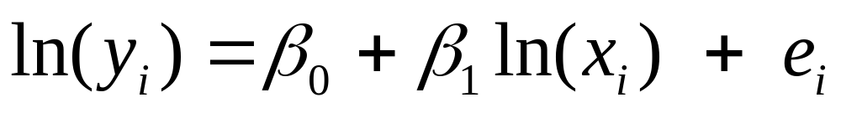
5.2.4 Log Transformations of Both the y and x Variables
Here the natural log of y is the dependent variable and the natural log of x is the independent variable:
Comparing results with other models may be difficult since we are not modeling y itself.
Economists sometimes use this to estimate price elasticity (y is demand and x price; b₁ is estimated elasticity).
Fitting Curves to Data
Copyright © 2005 Brooks/Cole, a division of Thomson Learning, Inc.

Slide 56
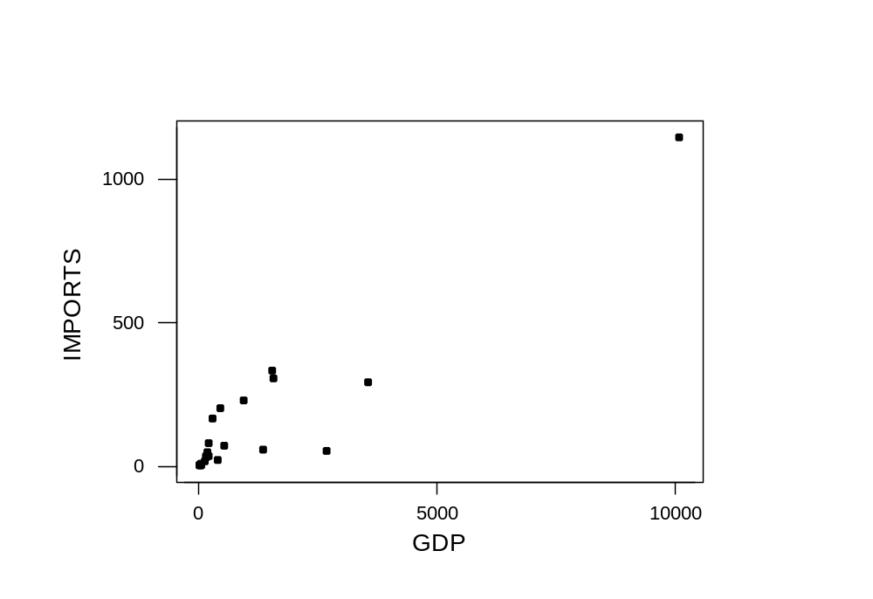
Scatterplot of Imports vs GDP
Fitting Curves to Data
Copyright © 2005 Brooks/Cole, a division of Thomson Learning, Inc.

Slide 57
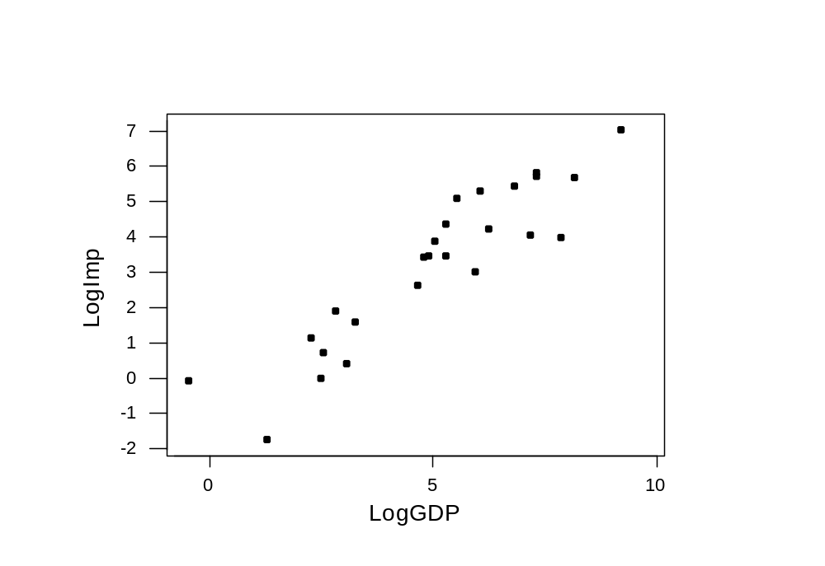
Scatterplot of LogImp vs LogGDP
Fitting Curves to Data
Copyright © 2005 Brooks/Cole, a division of Thomson Learning, Inc.

Slide 58
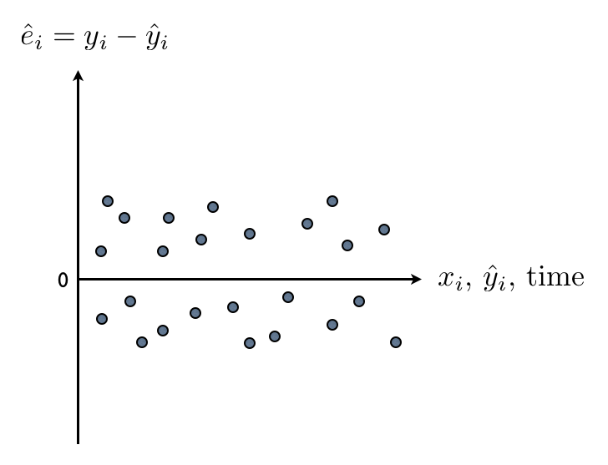
Residual Plot
No pattern around zero
The same variance
Checking Assumptions
Copyright © 2005 Brooks/Cole, a division of Thomson Learning, Inc.

Slide 59
Standardized residuals
The residuals can be standardized by dividing by their standard error.
This will not change the pattern in a plot but will affect the vertical scale.
Standardized residuals are always scaled so that most are between -2 and +2 as in a standard normal distribution.
Checking Assumptions
Copyright © 2005 Brooks/Cole, a division of Thomson Learning, Inc.

Slide 60
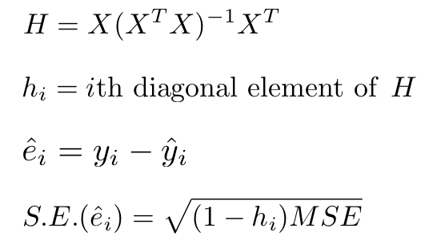
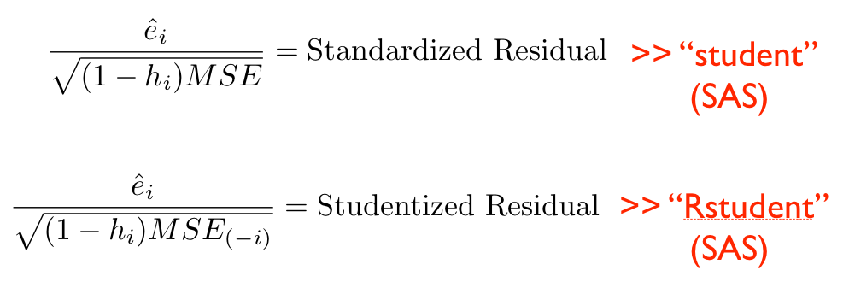
Checking Assumptions
Copyright © 2005 Brooks/Cole, a division of Thomson Learning, Inc.

Slide 61
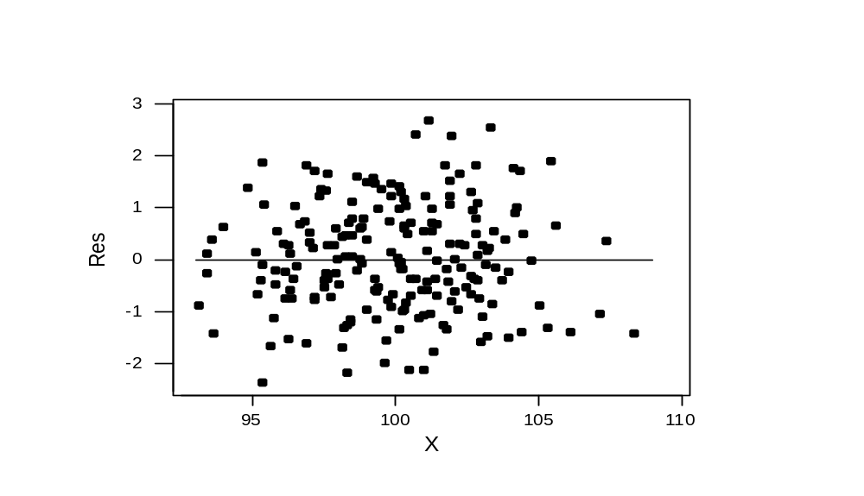
A plot meeting property 2
a. mean of 0 b. Same scatter d. No pattern with X
Checking Assumptions
Copyright © 2005 Brooks/Cole, a division of Thomson Learning, Inc.

Slide 62
Lack of fit
If nonlinearity is suspected, there are tests available for lack of fit.
Minitab has two versions of this test, one requiring there to be repeated observations at the same X values.
These are on the Options submenu off the Regression menu
Checking Assumptions
Copyright © 2005 Brooks/Cole, a division of Thomson Learning, Inc.

Slide 63
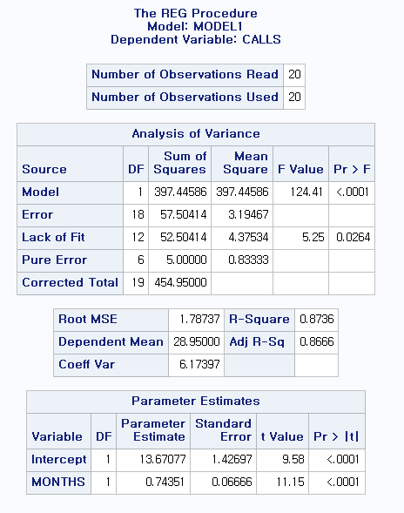
proc reg data = a; model calls = months / lackfit ; run;
H0 : Lack of Fit = 0
Reject H0 > not linear
Copyright © 2005 Brooks/Cole, a division of Thomson Learning, Inc.

Slide 64

Normal plot (from regression graphs)
If normal, should follow straight line
Checking Assumptions
Copyright © 2005 Brooks/Cole, a division of Thomson Learning, Inc.

Slide 65
Outlier (이상점) : Y-direction
Leverage Point (지렛대점): X-direction
Influential Point (영향점)
Checking Assumptions
Copyright © 2005 Brooks/Cole, a division of Thomson Learning, Inc.

Slide 66

Influential Point (영향점)
Outlier
Leverage point
Checking Assumptions
Copyright © 2005 Brooks/Cole, a division of Thomson Learning, Inc.

Slide 67



Contour Plot for the h_i
Copyright © 2005 Brooks/Cole, a division of Thomson Learning, Inc.

Slide 68

Leverage Point
h > 2(K+1)/n= 0.171
h₁₉ = .764
Checking Assumptions
Copyright © 2005 Brooks/Cole, a division of Thomson Learning, Inc.

Slide 69

Leverage & Outlier
Is there any Combined Measure?
Checking Assumptions
Copyright © 2005 Brooks/Cole, a division of Thomson Learning, Inc.

Slide 70

DFIT Graphed
29
19
Checking Assumptions
Copyright © 2005 Brooks/Cole, a division of Thomson Learning, Inc.

Slide 71

Cook's D Graphed
29
19
Checking Assumptions
Copyright © 2005 Brooks/Cole, a division of Thomson Learning, Inc.

Slide 72

Bubble Plot for Cook’s D
Checking Assumptions
Copyright © 2005 Brooks/Cole, a division of Thomson Learning, Inc.

Slide 73
First-order autocorrelation
If the disturbances have first-order autocorrelation, they behave as:
e_{i} = ρ e_{i-1} + µ_{i}
where µ_{i} is a disturbance with expected value 0 and independent over time.
Checking Assumptions
Copyright © 2005 Brooks/Cole, a division of Thomson Learning, Inc.

Slide 74
6.8.2 A Test for First-Order Autocorrelation
Durbin and Watson developed a test for positive autocorrelation of the form:
H₀: ρ = 0
H_{a}: ρ > 0
Their test statistic d is scaled so that it is 2 if no autocorrelation is present and near 0 if it is very strong.
Checking Assumptions
Copyright © 2005 Brooks/Cole, a division of Thomson Learning, Inc.

Slide 75
The Test
n = 36 and K = 1 X-variable
At a 5% level of significance, Table B.7 gives d_{L} = 1.41 and d_{U} = 1.52
Decision Rule:
  Reject H₀ if d < 1.41
  Accept H₀ if d > 1.52
  Inconclusive if 1.41 ≤ d ≤ 1.52
Checking Assumptions
Copyright © 2005 Brooks/Cole, a division of Thomson Learning, Inc.

Slide 76
An Example
D_{i} = 1 if individual i is employed
D_{i} = 0 if individual i is not employed
We could do it the other way and use the "1" to indicate an unemployed individual.
Indicator Variables
Copyright © 2005 Brooks/Cole, a division of Thomson Learning, Inc.

Slide 77

Parallel Salary Equations
Indicator Variables
Copyright © 2005 Brooks/Cole, a division of Thomson Learning, Inc.

Slide 78
Is The Difference Significant?
H₀: β_{MALES} = 0
H_{a}: β_{MALES} ≠ 0
Use t = b/SE_{b} as usual
t = 5.23 is significant
(After accounting for years of education, there is no salary difference)
(After accounting for education, there IS a salary difference)
Indicator Variables
Copyright © 2005 Brooks/Cole, a division of Thomson Learning, Inc.

Slide 79
Example 7.3 Meddicorp Sales
Y = Sales in one of 25 territories
X₁ = advertising in territory
X₂ = bonuses paid in territory
Also Region: 1 = South
2 = West
3 = Midwest
Indicator Variables
Copyright © 2005 Brooks/Cole, a division of Thomson Learning, Inc.

Slide 80
Coding scheme
Region | D₁ South | D₂ West
SOUTH
WEST
MIDWEST
1
0
0
0
1
0
Indicator Variables
Copyright © 2005 Brooks/Cole, a division of Thomson Learning, Inc.

Slide 81
7.2 Interaction Variables
Another type of variable used in regression models is an interaction variable.
This is usually formulated as the product of two variables; for example, x₃ = x₁x₂
With this variable in the model, it means the level of x₂ changes how x₁ affects Y
Indicator Variables
Copyright © 2005 Brooks/Cole, a division of Thomson Learning, Inc.

Slide 82


Interaction Model
With two x variables the model is:
If we factor out x₁ we get:
so each value of x₂ yields a different slope in the relationship between y and x₁
Indicator Variables
Copyright © 2005 Brooks/Cole, a division of Thomson Learning, Inc.

Slide 83

Lines With Two Different Slopes
A bigger gap occurs at higher education levels
Indicator Variables
Copyright © 2005 Brooks/Cole, a division of Thomson Learning, Inc.

Slide 84
Seasonal Adjustment
 | Q1 | Q2 | Q3
1st Quarter | 1 | 0 | 0
2nd Quarter | 0 | 1 | 0
3rd Quarter | 0 | 0 | 1
4th Quarter (BASE) | 0 | 0 | 0
Indicator Variables
Copyright © 2005 Brooks/Cole, a division of Thomson Learning, Inc.

Slide 85

ABX Company Sales
4th qtr
Indicator Variables
Copyright © 2005 Brooks/Cole, a division of Thomson Learning, Inc.

Slide 86

Are the Seasonal Effects Significant?
The strong t-ratios for Q2 and Q3 say "yes" and the model R² increased by 17.6% when we added the seasonal indicators.
With evidence this strong we probably don't need to test further.
In general, however, we would need another partial F test to see if the overall seasonal effect is significant.
Indicator Variables
Copyright © 2005 Brooks/Cole, a division of Thomson Learning, Inc.

Slide 87
Strategies
All possible regressions: computer procedures that briefly examine every possible combination of Xs and report summaries of fit ability.
Selection algorithms: rules for deciding when to drop or add variables
    Backwards Elimination
    Forward Selection
    Stepwise Regression
Copyright © 2005 Brooks/Cole, a division of Thomson Learning, Inc.
Variable Selection

Slide 88
The C_{p} Statistic
p = k + 1 is the number of terms in the model, including the intercept.
SSE_{p} is the SSE of this model
MSE_{F} is the MSE in the "full model" (with all the variables)
SSE_{p}
C_{p} = - (n – 2p)
MSE_{F}
Copyright © 2005 Brooks/Cole, a division of Thomson Learning, Inc.
Variable Selection

Slide 89
8.4 Which Procedure is Best?
Unless there are too many x variables, the all possible models approach is favored because it looks at all combinations of variables.
Of the other strategies, stepwise regression is probably best.
If no search programs are available, backwards elimination can still provide a useful sifting of the data.
Copyright © 2005 Brooks/Cole, a division of Thomson Learning, Inc.
Variable Selection

Slide 90
No Guarantees
Because they do not check assumptions or examine the model residuals, there is no guarantee of returning the right model.
Nonetheless, these can be effective tools filtering the data and identifying which variables to pay more attention to.
Copyright © 2005 Brooks/Cole, a division of Thomson Learning, Inc.
Variable Selection

